Slide 1
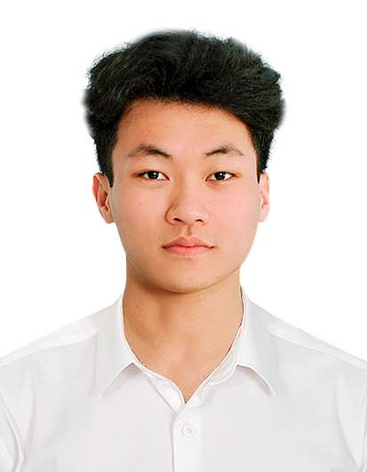
National Kaohsiung University of Science and Technology
Department of Electronics Engineering
Contact information: trantuan22052k@gmail.com
Thesis title: Decode barcode image using YOLOv8 and REAL-ESRGAN
Can solve the problem of reading and decoding low-resolution images barcode.
The most interesting thing is The most interesting thing is image enhancement and restoration in a specific zone, which makes computers use fewer resources.
Expertise in subjects: Computer Vision.
The works I have done include: Read the research paper, learn about object detection methods, image improvement methods using generative neural networks, and implement code.
Works I have published: Decode barcode image using YOLOv8 and REAL-ESRGAN.
Received honors and awards: Member of the communications and diplomacy committee of the Vietnamese Student Association in Kaohsiung-Taiwan.
Preferred working location: No. 415, Jiangong Rd., Kaohsiung City 80778, Taiwan (R.O.C.)
What you hope to do: I want to be someone who can contribute to helping people.
Others: I would like to express my deep gratitude to all the teachers and classmates who have helped me throughout the process of working and studying at國立高雄科技大學.

Slide 2

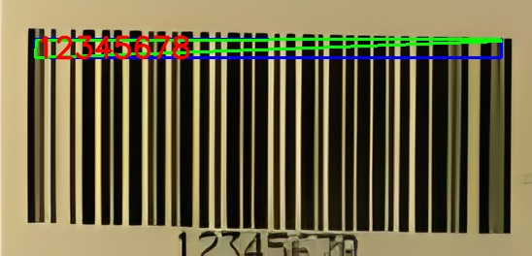
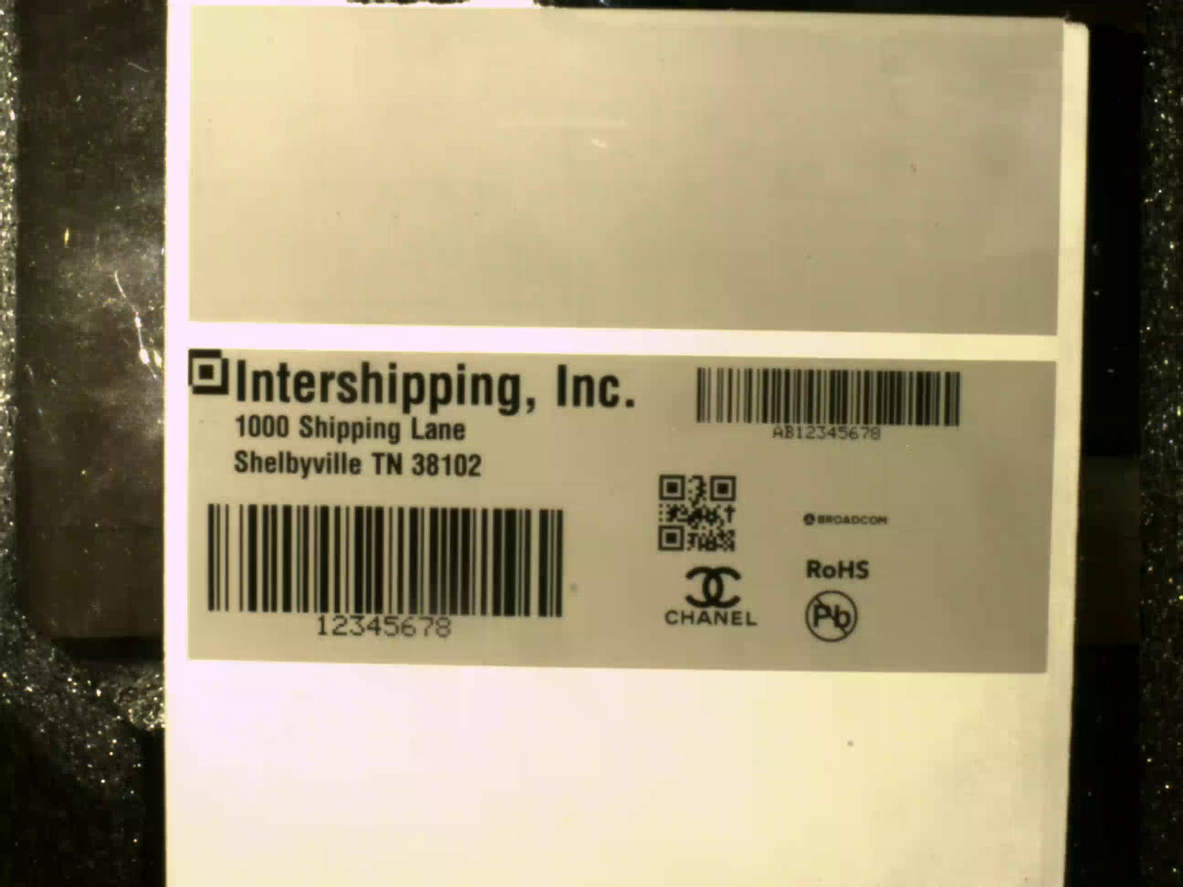

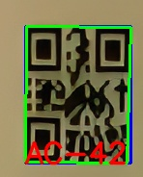
System workflow, deploy and test on practical data
Decode barcode image using YOLOv8 and REAL-ESRGAN
System workflow
Image resized 416x416
Yolov8 detected barcodes image
Real-ESRGAN restores the image barcodes
Use Pyzbar libraries to decode restored Image barcodes
137x66
548x264
X4
37x46
148x184
X4

